Slide 1
GREEDY METHOD
Minimum Cost Spanning Tree Problem

Slide 2
Insights
Graph
Spanning Tree
Minimum Cost Spanning Tree
Minimum Cost Spanning Tree Problem
Solution to the Problem
KRUSKAL’s Algorithm
Steps
Algorithm
Time Complexity
PRIM’s Algorithm
Steps
Algorithm
Time Complexity
Differences between KRUSKAL’s and PRIM’s Algorithm

Slide 3
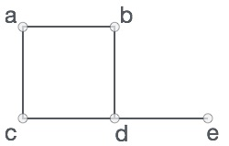
Graph
A graph is a pictorial representation of a set of objects where some pairs of objects are connected by links.
The interconnected objects are represented by points termed as vertices (V), and the links that connect the vertices are called edges (E).
Formally, a graph is a pair of sets (V, E), where V is the set of vertices and E is the set of edges, connecting the pairs of vertices. Take a look at the following graph −
In the above graph,
V = {a, b, c, d, e}
E = {ab, ac, bd, cd, de}
Types:
Directed Graph
Undirected Graph
Connected Graph
Connected Graph with weights

Slide 4
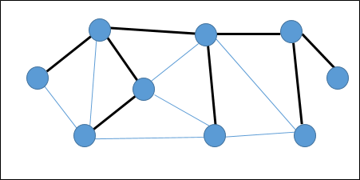
Spanning Tree
Let G = (V, E) be an undirected connected graph.
A subgraph T = (V, É) of G is a spanning tree of G iff T is a tree.
In a graph, there may exist more than one spanning tree.
Example:
In the above graph, the highlighted edges form a spanning tree.

Slide 5
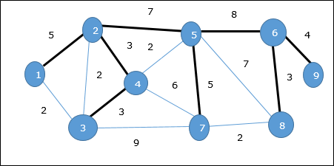
Minimum Cost Spanning Tree (MST)
A Minimum Spanning Tree (MST) is a subset of edges of a connected weighted undirected graph that connects all the vertices together with the minimum possible total edge weight.
The cost of this spanning tree is (5 + 7 + 3 + 3 + 5 + 8 + 3 + 4) = 38.
MST will be computed Next………….

Slide 6
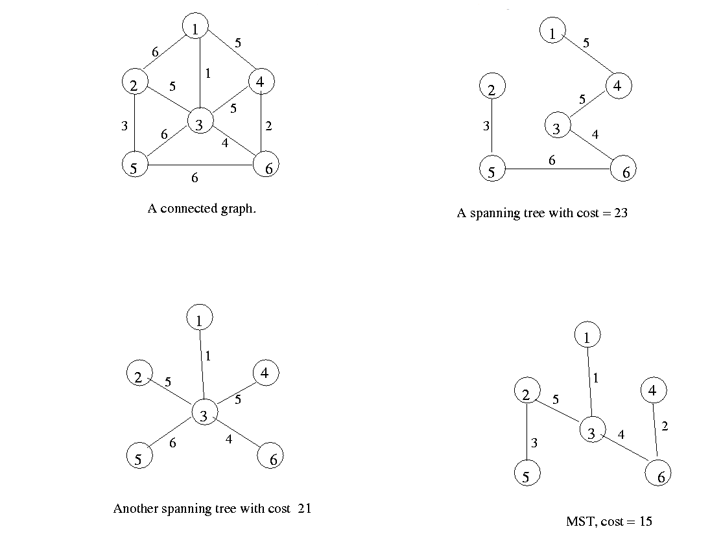
Minimum Cost Spanning Tree (MST)

Slide 7
Minimum Cost Spanning Tree - Problem
Find MST for the below GRAPH
2
8
3
7
4
1
9
2
1
11
9
4
14
5
7
16
8
10
8
7
2
6
4

Slide 8
Minimum Cost Spanning Tree – KRUSKAL’s Algorithm
Start with a forest that has no edges.
Add the next minimum cost edge to the forest if it will not cause a cycle.
Continue this process until the tree has n - 1 edges.

Slide 9
Minimum Cost Spanning Tree – KRUSKAL’s Algorithm
2
8
3
7
4
1
9
2
1
11
✗
9
4
14
5
✗
7
16
8
10
8
7
2
6
4
2
3
4
1
9
5
8
7
6

Slide 10
Minimum Cost Spanning Tree – KRUSKAL’s Algorithm
9
4
5
5
3
8
4
9
3
6
8
6
2
1
2
2
4
4
7
7
8
8
9
10
14
16
1
9
7
7
3
Does not form cycle
3
8
2
1
4
6
6
3
7
2
4
9
5
1
8
7
6
Forms cycle

Slide 11
Minimum Cost Spanning Tree – KRUSKAL’s Algorithm
Algorithm kruskal(E,cost,n,t)
// E is the set of edges in G.G has n vertices.cost[u,v] is the cost of edge(u,v).
//t is the set of edges in the minimum– cost //spanning tree. the final cost is returned.
{
Construct a heap out of the edge costs using Heapify;
for i=1 to n do parent[i]=-1;
//each vertex is in a different set.
i=0;
mincost=0;
while((i<n-1) and (heap not empty)) do
{
delete a minimum cost edge (u,v) from the heap and reheapify using Adjust;
j=Find(u);
K=Find(v);
if(j!=k) then
{
i=i+1;
t[I,1]=u;
t[I,2]=v;
mincost=mincost+cos[u,v];
Union(j, k);
}
}
If(i!=n-1) then
write(“no spanning tree”);
else
return mincost;
}

Slide 12
Minimum Cost Spanning Tree – KRUSKAL’s Algorithm
1
28
10
2
1
14
16
2
6
7
3
6
7
3
24
18
25
12
5
22
4
5
4

Slide 13
Minimum Cost Spanning Tree – KRUSKAL’s Algorithm
1
28
10
2
1
14
16
2
6
7
3
6
7
3
24
18
25
12
5
22
4
5
4

Slide 14
Minimum Cost Spanning Tree – KRUSKAL’s Algorithm
1
28
2
1
14
16
2
10
6
7
3
6
7
3
24
18
25
12
5
22
4
5
4

Slide 15
Minimum Cost Spanning Tree – KRUSKAL’s Algorithm
1
28
2
1
14
16
2
10
6
7
3
6
7
3
24
18
25
12
5
22
4
5
4

Slide 16
Minimum Cost Spanning Tree – KRUSKAL’s Algorithm
1
28
2
1
14
16
2
10
6
7
3
6
7
3
24
18
25
5
12
22
4
5
4

Slide 17
Minimum Cost Spanning Tree – KRUSKAL’s Algorithm
1
28
2
1
14
16
2
10
6
7
3
6
7
3
24
18
25
5
12
22
4
5
4

Slide 18
Minimum Cost Spanning Tree – KRUSKAL’s Algorithm
1
28
2
1
16
10
2
6
7
14
3
6
7
3
24
18
25
5
12
22
4
5
4

Slide 19
Minimum Cost Spanning Tree – KRUSKAL’s Algorithm
1
28
2
1
16
2
10
6
7
14
3
6
7
3
24
18
25
5
12
22
4
5
4

Slide 20
Minimum Cost Spanning Tree – KRUSKAL’s Algorithm
1
28
2
1
2
10
6
7
14
16
3
6
7
3
24
18
25
5
12
22
4
5
4

Slide 21
Minimum Cost Spanning Tree – KRUSKAL’s Algorithm
1
28
2
1
2
10
6
7
14
16
3
6
7
3
24
18
25
5
12
22
4
5
4

Slide 22
Minimum Cost Spanning Tree – KRUSKAL’s Algorithm
1
28
2
1
2
10
6
7
14
16
3
6
7
3
24
25
5
18
12
22
4
5
4

Slide 23
Minimum Cost Spanning Tree – KRUSKAL’s Algorithm
1
28
2
1
2
10
6
7
14
16
3
6
7
3
24
18
25
5
12
22
4
5
4

Slide 24
Minimum Cost Spanning Tree – KRUSKAL’s Algorithm
1
28
2
1
2
10
6
7
14
16
3
6
7
3
24
18
25
5
12
22
4
5
4

Slide 25
Minimum Cost Spanning Tree – KRUSKAL’s Algorithm
1
28
2
1
2
10
6
7
14
16
3
6
7
3
24
18
25
5
12
4
5
22
4

Slide 26
Minimum Cost Spanning Tree – KRUSKAL’s Algorithm
1
28
2
1
2
10
6
7
14
16
3
6
7
3
24
18
25
5
12
4
5
22
4

Slide 27
Minimum Cost Spanning Tree – KRUSKAL’s Algorithm
1
28
2
1
2
10
6
7
14
16
3
6
7
3
25
18
24
5
12
4
5
22
4

Slide 28
Minimum Cost Spanning Tree – KRUSKAL’s Algorithm
1
28
2
1
2
10
6
7
14
16
3
6
7
3
25
24
18
5
12
4
5
22
4

Slide 29
Minimum Cost Spanning Tree – KRUSKAL’s Algorithm
1
28
2
1
2
10
6
7
14
16
3
24
6
7
3
25
18
5
12
4
5
22
4

Slide 30
Minimum Cost Spanning Tree – KRUSKAL’s Algorithm
1
28
2
1
2
10
6
7
14
16
3
24
6
7
3
18
5
25
12
4
5
22
4

Slide 31
Time complexity of kruskal’s algorithm
Minimum Cost Spanning Tree – KRUSKAL’s Algorithm
With an efficient Find-set and union algorithms, the running time of kruskal’s algorithm will be dominated by the time needed for sorting the edge costs of a given graph.
Hence, with an efficient sorting algorithm(merge sort), the complexity of kruskal’s algorithm is O( ElogE).

Slide 32
Minimum Cost Spanning Tree – PRIM’s Algorithm
2
8
3
7
4
2
3
4
1
9
2
1
1
i
5
11
9
4
14
5
7
16
8
10
8
7
6
8
4
7
2
6
2
3
4
1
9
5
8
7
6

Slide 33
Minimum Cost Spanning Tree – PRIM’s Algorithm
Prim’s Algorithm
1 Algorithm Prim(E, cost, n, t)
2 // E is the set of edges in G.
//cost[1:n,1:n] is the cost matrix such that cost[i,j] is either
4 // positive real number or ∞ if no edge (i,j) exists. cost[i,j]=0, if i=j.
5 // A minimum spanning tree is computed and stored
6 // as a set of edges in the array t[1:n-1,1:2]
7 {
8 Let (k,l) be an edge of minimum cost in E
9 mincost=cost[k,l];
t[1,1]=k; t[1,2]=l;
for i=1 to n do // initialize near
if( cost[i,l]< cost[i, k] then near[i]=l;
else near[i]= k;
13 near[k]=near[l]=0;
14 for i=2 to n-1 do
15 {
// Find n-1 additional edges for t.
17Let j be an index such that near[j]≠0 and
cost[j,near[j]] is minimum;
19 t[i,1]=j; t[i,2]=near[j];
20 mincost=mincost+cost[j,near[j]];
near[j]=0;
22for k=1 to n do // update near[]
23if( ( near[k] ≠0 ) and (cost[k,near[k]>cost[k,j])) then
24 near[k]=j;
25 }
26 return mincost;
27 }

Slide 34
Minimum Cost Spanning Tree – KRUSKAL’s Algorithm
1
28
10
2
1
14
16
2
6
7
3
6
7
3
24
18
25
12
5
22
4
5
4

Slide 35
Minimum Cost Spanning Tree – KRUSKAL’s Algorithm
1
28
10
2
1
14
16
2
6
7
3
6
7
3
24
18
25
12
5
22
4
5
4

Slide 36
Minimum Cost Spanning Tree – KRUSKAL’s Algorithm
1
28
2
1
14
16
10
2
6
7
3
6
7
3
24
18
25
12
5
22
4
5
4

Slide 37
Minimum Cost Spanning Tree – KRUSKAL’s Algorithm
1
28
2
1
(1, 28)
14
16
10
2
6
7
3
(1, INF)
24
6
7
3
18
(1, INF)
25
12
5
22
4
5
4
(6, 25)
(1, INF)

Slide 38
Minimum Cost Spanning Tree – KRUSKAL’s Algorithm
1
28
2
1
(1, 28)
14
16
10
2
6
7
3
(1, INF)
6
7
3
24
18
(1, INF)
25
12
5
22
4
5
4
(6, 25)
(1, INF)

Slide 39
Minimum Cost Spanning Tree – KRUSKAL’s Algorithm
1
28
2
1
(1, 28)
14
16
10
2
6
7
3
(5, 24)
6
7
3
24
18
(1, INF)
12
5
25
22
4
5
4
(6, 25)
(5, 22)

Slide 40
Minimum Cost Spanning Tree – KRUSKAL’s Algorithm
1
28
2
1
(1, 28)
14
16
10
2
6
7
3
(5, 24)
6
7
3
24
18
(1, INF)
12
5
25
22
4
5
4
(6, 25)
(5, 22)

Slide 41
Minimum Cost Spanning Tree – KRUSKAL’s Algorithm
1
28
2
1
(1, 28)
14
16
10
2
6
7
3
(4, 18)
6
7
3
24
18
(4, 12)
12
5
25
4
5
4
(6, 25)
22
(5, 22)

Slide 42
Minimum Cost Spanning Tree – KRUSKAL’s Algorithm
1
28
2
1
(1, 28)
14
16
10
2
6
7
3
(4, 18)
6
7
3
24
18
(4, 12)
12
5
25
4
5
4
(6, 25)
22
(5, 22)

Slide 43
Minimum Cost Spanning Tree – KRUSKAL’s Algorithm
1
28
2
1
(3, 16)
14
16
10
2
6
7
3
(4, 18)
6
7
3
24
18
(4, 12)
5
25
12
4
5
4
(6, 25)
22
(5, 22)

Slide 44
Minimum Cost Spanning Tree – KRUSKAL’s Algorithm
1
28
2
1
(3, 16)
14
16
10
2
6
7
3
(4, 18)
6
7
3
24
18
(4, 12)
5
25
12
4
5
4
(6, 25)
22
(5, 22)

Slide 45
Minimum Cost Spanning Tree – KRUSKAL’s Algorithm
28
1
2
1
(3, 16)
14
10
2
6
7
16
3
(3, 16)
24
6
7
3
18
(4, 12)
5
25
12
4
5
4
(6, 25)
22
(5, 22)

Slide 46
Minimum Cost Spanning Tree – KRUSKAL’s Algorithm
1
28
2
1
(3, 16)
14
10
2
6
7
16
3
(3, 16)
6
7
3
24
18
(4, 12)
5
25
12
4
5
4
(6, 25)
22
(5, 22)

Slide 47
Minimum Cost Spanning Tree – KRUSKAL’s Algorithm
1
28
2
1
(3, 16)
10
2
6
7
14
16
3
(3, 16)
6
7
3
24
18
(4, 12)
5
25
12
4
5
4
(6, 25)
22
(5, 22)

Slide 48
Time complexity of Prims algorithm
Minimum Cost Spanning Tree – PRIM’s Algorithm
Line 8 takes o(E).
The for loop of line 12 takes o(n).
17 and 18 and the for loop of line 22 require o(n) time.
Each iteration of the for loop of line 14 takes o(n) time.
Therefore, the total time for the for loop of line 14 is o(n²).
Hence, time complexity of Prim is o(n²).

